Slide 1
Identification of Fake Images
Submitted in the partial fulfillment for the award of the degree of
BACHELOR OF ENGINEERING
IN
CSE - AIML
Submitted by:
Sriramoju Nikhil Sai (21BCS6617)
Boppana Bala Sai (21BCS6567)
Yama Sai Akshay (21BCS6587)
Under the Supervision of:
Dr. Surinder Chauhan
Department of AIT-CSE
DISCOVER . LEARN . EMPOWER

Slide 2
Outline
Introduction to Project
Problem Formulation
Objectives of the work
Methodology used
Results and Outputs
Conclusion
Future Scope
References

Slide 3
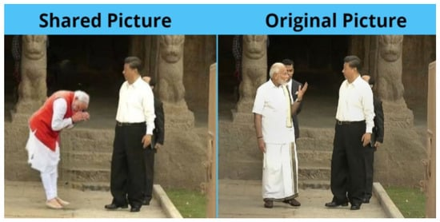
Introduction to Project
In today's digital age, it is becoming increasingly difficult to discern between real and fake images. This is due to the advancements in image editing software and the rise of deepfakes.
Understanding the impact of fake images is crucial in today's digital age. Machine learning offers a powerful tool for detecting and exposing deceptive visuals. This presentation will explore the potential of machine learning in unmasking fake images.

Slide 4
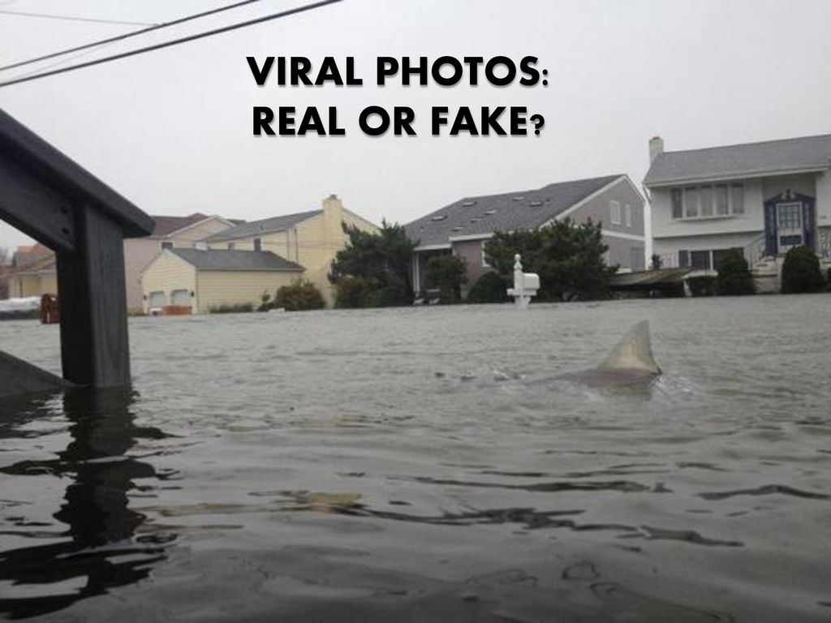
Introduction to Project
The goal is to creating an Model that can Detect the Fake Images, so that it can be used in real-time applications .

Slide 5
Problem Formulation
The problem formulation for identifying fake images involves designing algorithms that can effectively detect the fake images. This requires leveraging machine learning and natural language processing techniques for gathering various types of tampered images manipulated using single or multiple alterations and then, after processing, classifying them as real or false.

Slide 6
Objectives of the Work
Model for detecting fake images: Develop algorithms and models capable of Identifying whether the image is fake or real.
Preventing Misinformation and Propaganda: Identifying and removing these images helps maintain the integrity of information and protects individuals and communities from harmful influences.
Enhancing Cybersecurity: Deepfakes and other sophisticated image manipulations can be used to bypass security systems, such as facial recognition. Identifying these fake images plays a crucial role in enhancing cybersecurity measures and protecting sensitive systems and information.

Slide 7
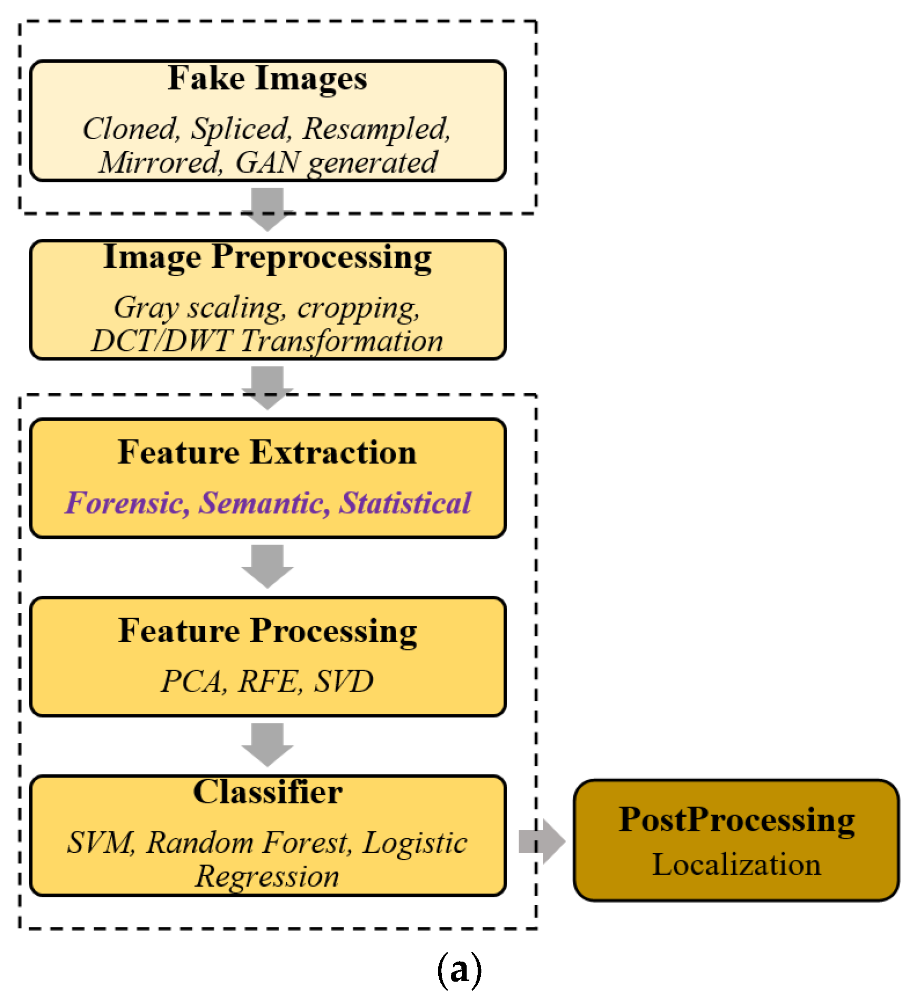
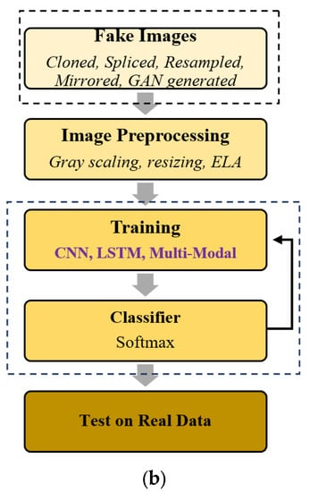
Methodology used
The methodology that we have used are CNN, as CNN can carry out automatic feature extraction for the given task. It eliminates the need for manual feature extraction, since the features are learned directly by the CNN.
Support Vector Machine (SVM) and Complement Naïve Bayes (CNB) were used in this process, to validate content based on text classification and data analysis
LBP-Local Binary Pattern is a type of visual descriptor used for classification in computer vision and is a simple yet very effiecient texture operator which labels the pixels of an image by thresholding the neighborhood of each pixel and considers the result as binary number.In our project we are designing LBP based machine learninig Convolution Neural Network called LBPNET to detect fake images.

Slide 8
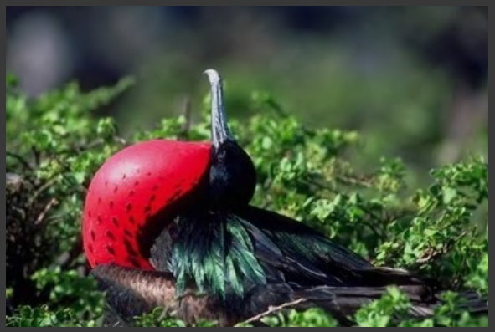
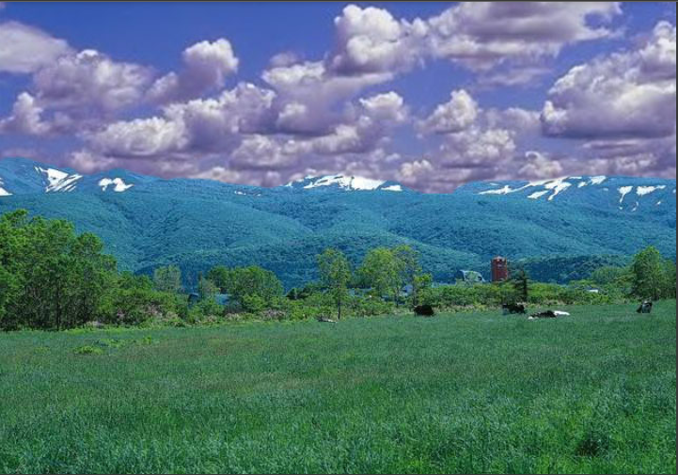


Results and Outputs
Fake image detection using machine learning typically involves training a model on a dataset of both real and fake images, and then using that model to classify new images as either real or fake. The results of fake image detection using machine learning can vary depending on a variety of factors, such as the quality of the training data, the complexity of the model, and the specific techniques used for detecting fakes. In general, machine learning algorithms can be quite effective at detecting certain types of fake images, such as those generated by simple image manipulation techniques like resizing or cropping. However, detecting more sophisticated fakes, such as deepfakes, can be more challenging.

Slide 9
Conclusion
This project on recognizing and reducing fake Images on social media platforms delves into critical issues in this domain. Fake images on social media have become a pressing concern, prompting social media platforms to combat this issue. This survey assesses various techniques for identifying fake pictures on these platforms. This paper discusses different tampering methods for creating fake images, from conventional to recent Generative Adversarial Network (GAN)-generated manipulations. It highlights the fake image detection process, reviewing multiple detection methods, including those using handcrafted features and neural network-based approaches. Also emphasizes recent neural network-based detection methods based on Convolutional Neural Network (CNN) architectures. CNNs are also efficient in detecting deepfake images and videos.
In summary, fake image detection through machine learning holds immense potential in combating misinformation, showcasing its evolving significance in the ongoing battle against fake news and misinformation.

Slide 10
Future Scope
Broader Scope of Fakes like:
Beyond images: Expand detection capabilities to encompass manipulated videos, audio recordings, and other forms of digital content.
Counterfeit protection: Develop detection methods for protecting valuable works of art, historical documents, and other digital assets from manipulation.
Enhanced Detection Techniques:
Personalized detection: Explore user-specific and content-specific models that account for individual biases and adapt to different image categories (e.g., news vs. social media).
Explainable AI: Design interpretable models that shed light on how they detect fakes, fostering trust and understanding in their decisions.
Ethical Considerations:
Bias and fairness: Mitigate potential biases in detection algorithms to ensure equal and fair treatment across different groups and content types..
Privacy protection: Balance the need for detection with individual privacy rights and avoid generating harmful stereotypes or generalizations.

Slide 11
Time Table
21BCS6587​Week 1
21BCS6587​
Week 1
Week 2
21BCS6617
Explored the reasearch papers on object detection
Gone through the references and prepared PPT
21BCS6587
Explored the reasearch papers on Image captioning
Prepared Synopsis of the project
Explored the reasearch papers
on fake image detection
Prepared project proposal of the project​
21BCS6567

Slide 12
References
[1] G.Mohamed Sikandar, "100 Social Media Statistics You must know," [online] Available at: https://blog.statusbrew.com/social-mediastatistics-2018-for-business/ [Accessed 02 Mar 2019].
[2] Damian Radcliffe, Amanda Lam, "Social Media in the Middle East,"[online]Available:https://www.researchgate.net/publication/323185146_Social_Media_in_the_Middle_East_The_Story_of_2017[Accessed 06 Feb 2019].
[3] GMI_BLOGGER,"Saudi Arabia Social Media Statistics," GMI_blogger. [online] Available at:https://www.globalmediainsight.com/blog/saudi-arabia-social-media-statistics/ [Accessed 04 May 2019].
[4] Kit Smith,"49 Incredible Instagram Statistics,". Brandwatch. [online]
Available at: https://www.brandwatch.com/blog/instagram-stats/ [Accessed 10 May 2019].
[5] Selling Stock. (2014). Selling Stock. [online] Available at: https://www.selling-stock.com/Article/18-billion-images-uploaded-to-the-web-everyd [Accessed 12 Feb 2019].
[6] A. Krizhevsky, I. Sutskever, & G. E. Hinton, (2012). Imagenet classification with deep convolutional neural networks. In Advances in Neural Information Processing Systems, 1097–1105.

